Slide 1
Assignment #3 Shell script 프로그래밍 실습
20223104 허종윤

Slide 2
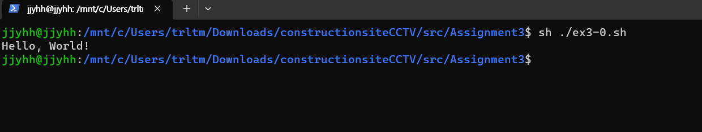
3-0
#!/bin/bash
echo "Hello World"
exit 0

Slide 3
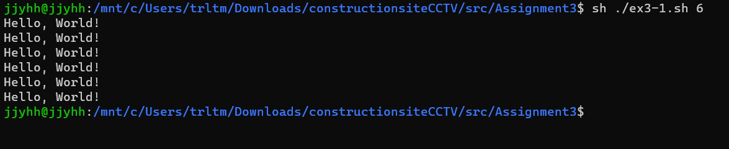
3-1
#!/bin/bash
# 명령줄 인자로 받은 숫자를 count 변수에 저장
count="$1"
# 입력된 숫자만큼 "Hello, World!"를 출력
i=1
while [ $i -le $count ]
do
echo "Hello, World!"
i=$((i + 1))
done

Slide 4
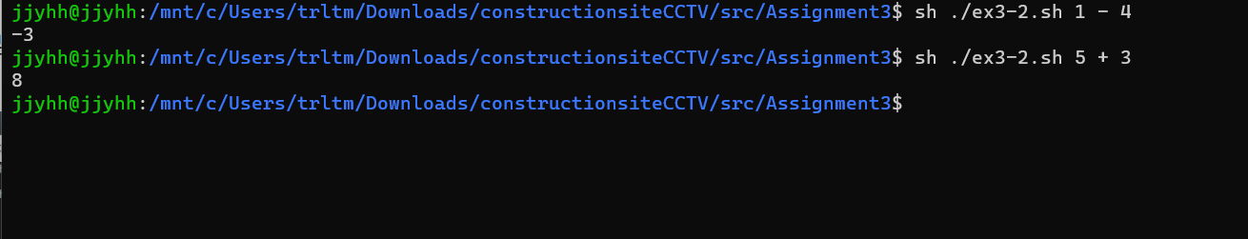
3-2
#!/bin/bash
case "$2" in
+)
expr $1 + $3;;
-)
expr $1 - $3;;
*)
echo "TRY AGAIN";;
esac
exit 0

Slide 5
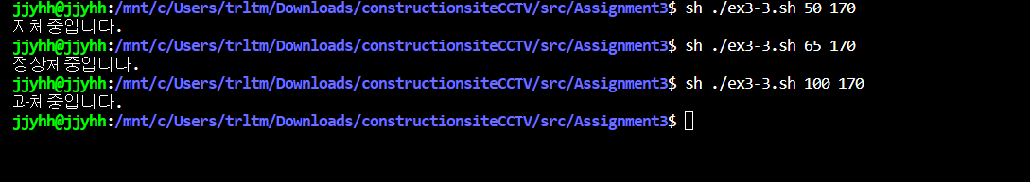
3-3
#!/bin/bash
bmi=$(( 100000 * $1 / $2 / $2))
if [ $bmi -gt 230 ]; then
echo "과체중입니다."
elif [ $bmi -ge 185 ]; then
echo "정상체중입니다."
else
echo "저체중입니다."
fi
exit 0

Slide 6
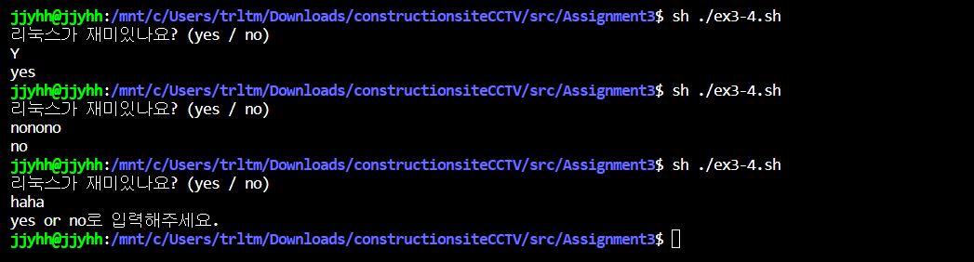
3-4
#!/bin/bash
echo "리눅스가 재미있나요? (yes / no)"
read answer
case $answer in
yes|Y|Yes|YES|y|maybe)
echo "yes";;
[nN]*)
echo "no";;
*)
echo "yes or no로 입력해주세요.";;
esac
exit 0

Slide 7
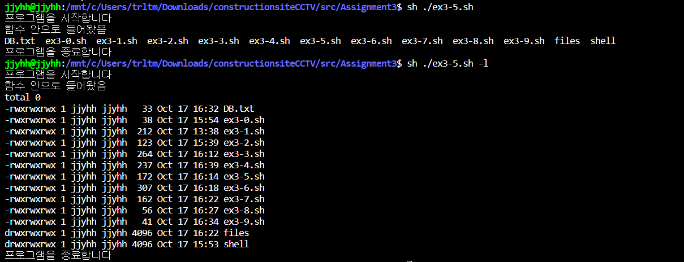
3-5
#!/bin/bash
checkfile ()
{
echo "함수 안으로 들어왔음"
ls $1
}
echo "프로그램을 시작합니다"
checkfile $1
echo "프로그램을 종료합니다"
exit 0

Slide 8
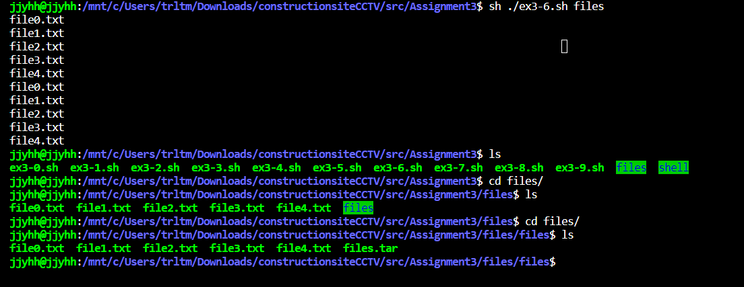
3-6
#!/bin/bash
dir=$(pwd)
if [ -d $1 ]
then
:
else
mkdir $1
cd $1
i=0
while [ $i -lt 5 ]
do
touch file$i.txt
i=$((i + 1))
done
tar cvf $1.tar file0.txt file1.txt file2.txt file3.txt file4.txt
mkdir $1
mv $1.tar $1
cd $1
tar xvf $1.tar
fi
exit 0

Slide 9
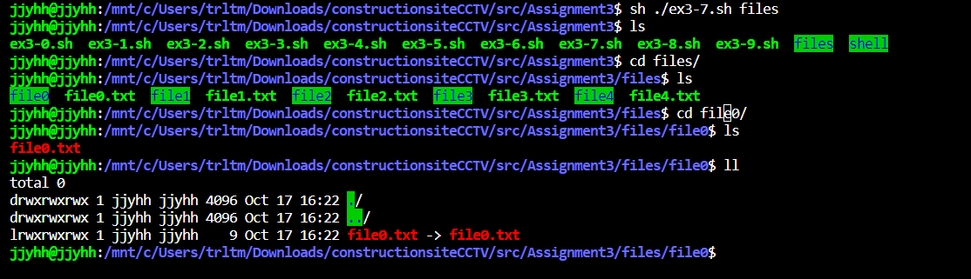
3-7
#!/bin/bash
mkdir $1
cd $1
i=0
while [ $i -lt 5 ]
do
mkdir file$i
touch file$i.txt
ln -s file$i.txt file$i/file$i.txt
i=$((i + 1))
done
exit 0

Slide 10
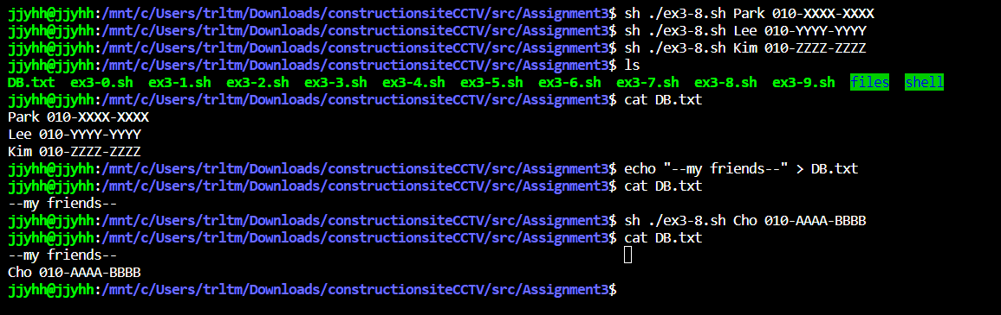
3-8
#!/bin/bash
touch DB.txt
echo $1 $2 >> DB.txt
exit 0

Slide 11
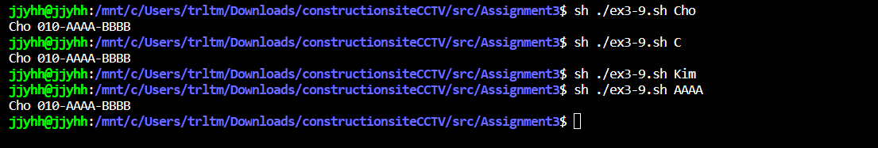
3-9
#!/bin/sh
sed -n "/$1/p" DB.txt
exit 0

